Slide 1
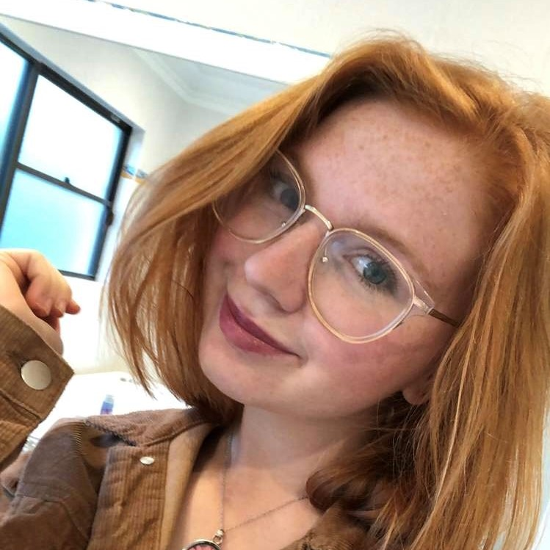
Brianna – Persona
Description
Brianna was an avid gamer before not having enough time to commit to much. Now she prefers short, engaging experiences that she can fit in her schedule.
Even though she doesn’t have the time to play many games, she still likes to talk about them with friends and watch in depth analyses.
Needs, Goals, & Motivations
Wants:
Co-op games – would rather play a party game with a group of friends
Nostalgia – likes games from when she was younger
Trusted opinion – if a game is recommended enough, she’ll get it
Gameplay & story – likes a compelling experience regardless of graphics/aesthetic
Basic Attributes
18
Female
Student
Retail Worker
PlayStation, Xbox, laptop
Australia
Behaviour
Plays game infrequently but will buy one if cheap
Will play games to procrastinate and loses track of time
Likes RPGs but goes for free ones because little free time
Frustrations
Doesn’t like having to sink a lot of time into a game due to schedule
Unclear instructions and unintuitive puzzles
Losing lots of progress because of infrequent saves
People taking games too seriously

